Slide 1

News Analytics
Kasun Daundaskara
Sabrina reed
Sebastian RAmirez

Slide 2
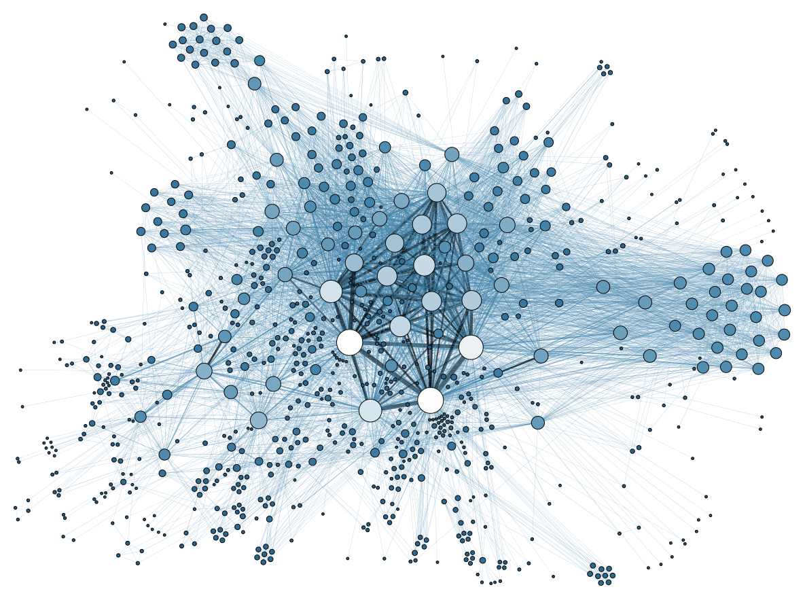
Content
Hypothesis
Data Sourcing
Data Exploration & Clean-up
Techniques
Evaluation
Insight
This Photo by Unknown Author is licensed under CC BY

Slide 3
Hypothesis
The motivation and core message for our project was to use deep learning sentiment analysis and NLP as a way to see if there are any relationships' between public opinion regarding an industry or stock in an attempt to predict values. Based on this type of analysis we will use NLP to parse through news article, media headlines obtain a sentiment analysis score, fit the data into a neural network model that calculates our weighted scores in order to make future predictions.

Slide 4

Data Sourcing
DATA
Kaggle
News API
Alpaca API
Twitter
Web CSV files
Github
StackOverflow
This Photo by Unknown Author is licensed under CC BY-SA-NC

Slide 5
Data Exploration & Clean up
Taking the imported CSV file that containing the features i.e.(id,ticker,title,category,content,release date, provider, url_id), dropped column we were not interested in, sorted our values based on date, assigned the new Data frame a new value with the desired features and dropped all nulls. After isolating the dates for joining our dataset, we took the original data frame and used the sentiment analyzer on the data and created a new Data frame containing the sentiment analysis of the textual data, and finally we concatenated the data with the dates allowing us to see how the changes in the data have affected the relative stock price.
Using the Alpaca API we brought in our stocks data and set the dates that we wanted to use for the analysis. The area of interest was the closing price as this will be used for our predictions. The index is reset so we can concatenate the previous data with our current stock prices. In the following step we added the close price to the original cleaned data frame matching close dates with article dates. This gives us our final cleaned data frame ready for modeling.

Slide 6
Modeling
Predictive models used LSTM with RNN:
Long short-term memory (LSTM) is an artificial recurrent neural network (RNN) architecture used in the field of deep learning. Unlike standard feedforward neural networks, LSTM has feedback connections. It can not only process single data points (such as images), but also entire sequences of data (such as speech or video).This was a good choice to model our data on because LSTM networks are well-suited to classifying, processing and making predictions based on time series data, since there can be lags of unknown duration between important events in a time series. LSTM is applicable to tasks such as unsegmented, connected handwriting recognition, speech recognition and anomaly detection in network traffic or IDSs (intrusion detection systems).
At the highest level RNN can use supervised learning to easily classify even deep sequences with long intervals between important events. Given a lot of learnable predictability in the incoming data sequence, the highest level RNN can use supervised learning to easily classify even deep sequences with long intervals between important events, and there for can be classified as unsupervised learning and semi-supervised learning.

Slide 7
Techniques
Functions
Min/Max – Scales down our features [0,1]
Test/Train uses features to create X/Y variables and allows to test the data after the conversions are made.
TensorFlow- Gives use our Neural Network, aids n adding layers to the model for testing.
Compile/summary – Data summary
Predict – Makes predictions
Inverse Transform / Transform - Recover the original prices instead of the scaled version
The EW functions support two variants of exponential weights
Crossover trading Signals – trading signal occurs when short-term moving average (SMA) crosses through a long-term moving average (LMA).
Min/Max Scaler
Train test split
Tensor-flow : Sequential, LSTM, Dense, Dropout
Compile / summary
Predict
Inverse transform/ transform
Exponentially Weighted Widows/ Moving Averages
Crossover Trading Signals

Slide 8
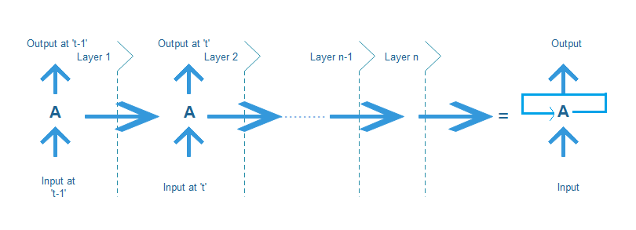
Evaluation
LTSM RNN (Long term short term memory) / Reccurent Neural Network.
To Evaluate the model, the team used (model. Evaluate(X_test, y_test)), and the result was 0.00582
Model Predict/evaluate for evaluation
Trading Signals

Slide 9
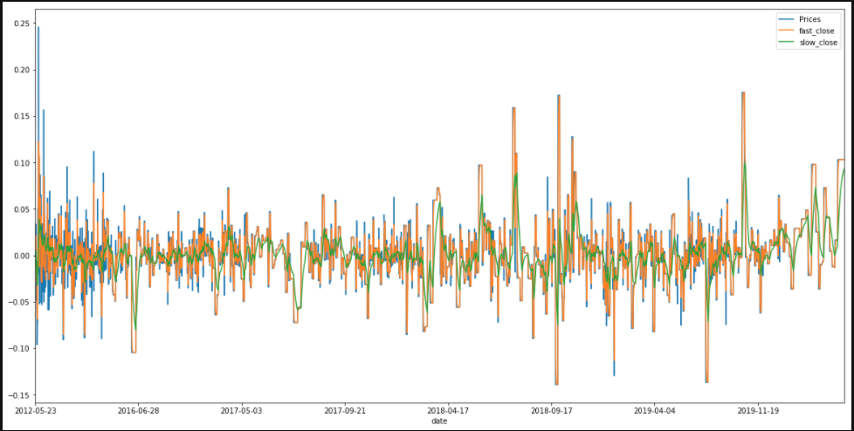
Trade-Signals

Slide 10
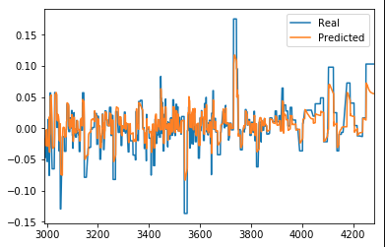
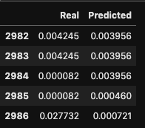

Slide 11
Insight
Issues
Conclusion
Beginning with API’s for news and stock prices we concatenated data frames for our model. Also explored using the Twitter API for sentiment analysis but could not get access to tweets older than 7 days which would not work with our stock data frame. For the model, we initially planned to use the compound score as our Y. As we evaluated our project and, we changed the Y to Stock Prices. However, using the stock prices didn’t provide a good model to visualize results. Therefore, we used percent change as the Y for our model.
Depending on what API we used we had some difficulty retrieving dates, due to specific requirements and limits on extracting dates for historical. We solved this by turning to CSV data that was much easier to work with and had enough data compared to obtaining data from twitter or News API.
To run the SentimentIntensityAnalyzer, we had to remove the date column because SentimentIntensityAnalyzer gives a problem with the date. To solve this problem team made a new data frame with just date and contact with SentimentIntensityAnalyzer result.
Trading signals were added as well to our model which seem to show where a buy or sell event would take place, based on our approach it would appear that when there is a negative price change that would indicate a time to buy the stock, where this also is represented by a negative trading signal trigger, had we had more time on this I would have placed a buy and sell column to more clearly visualize the buy and sell points in our data. This being said, We can conclude from our model and predictions that our predictions were not very good, using just text data and running the sentiment analysis did not seem to be enough to create a good model from predicting the stock price , This model could be more dynamic where we would require more than just stock and text data.

